Slide 1
Meeting Week 21
Last week summary
Augmentation
  Encoder Baseline
Outline ToDo next week

Slide 2
Last week summary
Discussed different encoder methods
  Hybrid encoder didn’t allow to flow gradients through it
  Jan’s linear encoder initialization
    Start with a good estimate
    But training worsened / was worse than init
  Culprit most likely was a parameter problem

Slide 3
Previous data
Only 8000 x 8 samples
  (Total 20khz at 2 seconds each)
Feedback that they were too stale
  Added oscillations
Why make new data
  Needed more data
  Too much of the motion profiles / data were hold positions at zero
    Besides when we add multisines on top off the trajectories
  More informative data / variation

Slide 4
More informative data
Oscillations and ramp up

Slide 5
More informative data
Oscillations and ramp up
For the baseline system (without MSD)
Also created trajectories + multisine
Frequency range 1-7hz gets surpressed by controller, but for baseline encoder this data should be informative enough without multisine
(For system with MSD multisine in the range 130-180hz, resonance is at 157hz)

Slide 6
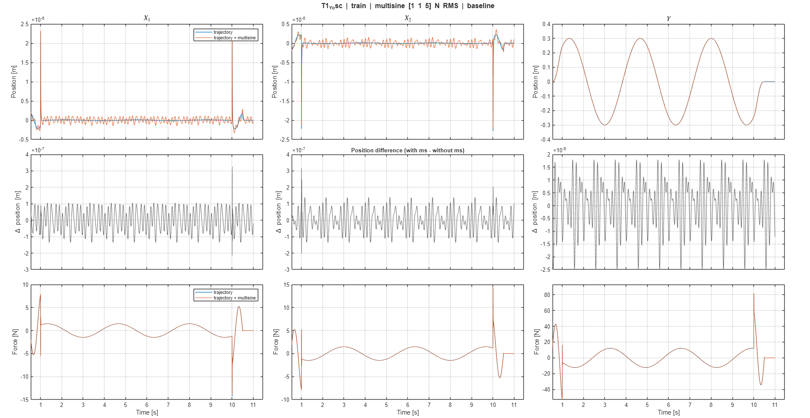

Slide 8
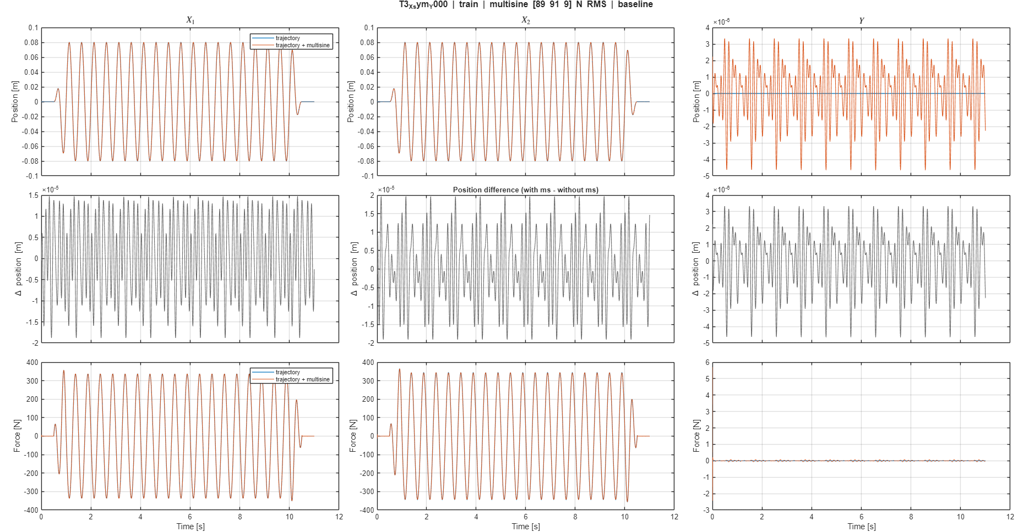

Slide 9
Downsampling
Look at whether rk4 degrades
Allows to run longer ??windows?? while still seeing entire trajectory.

Slide 10
Issue downsampling and encoder initialization

Slide 11
nf: number of samples
Main issue with increasing the sample length
  Scales with …
Currently grid search for nf and lr

Slide 12
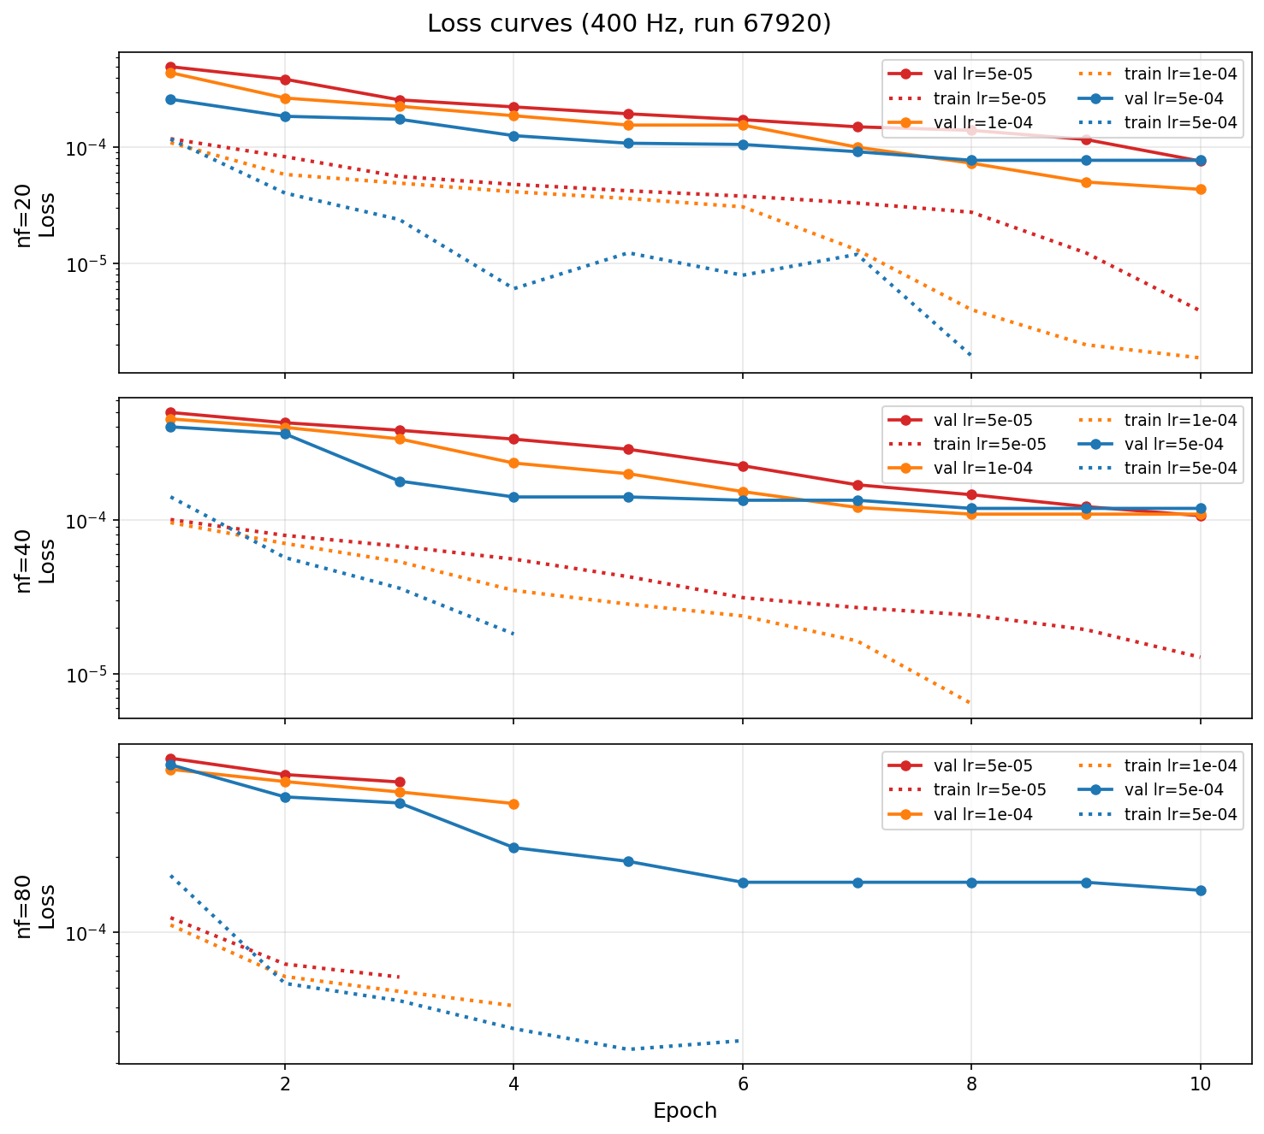
Encoder baseline
Only physical states
Initially didn’t converge. Test lr and nf combinations
  Current learning rate and nf all converge
Some loss returned Nan but training continued

Slide 13
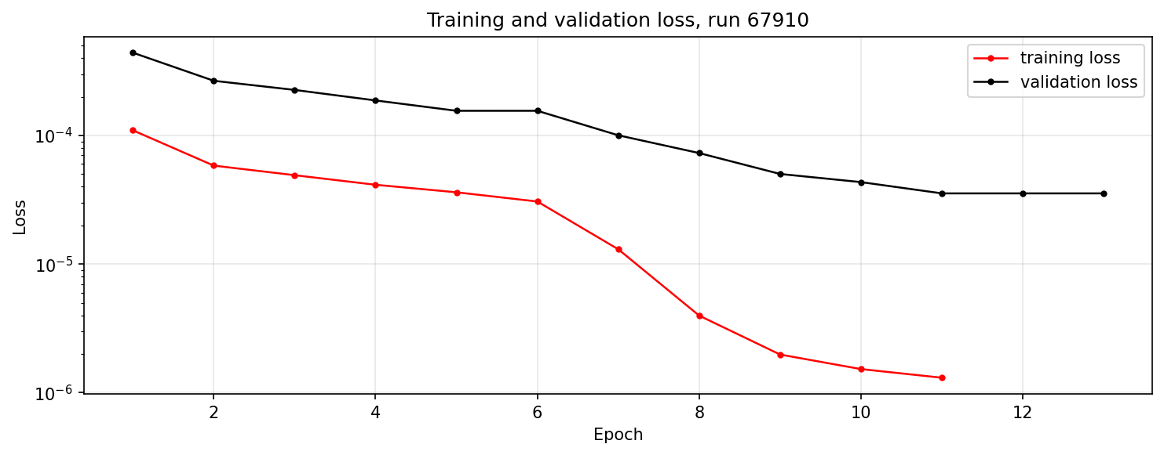

Slide 14
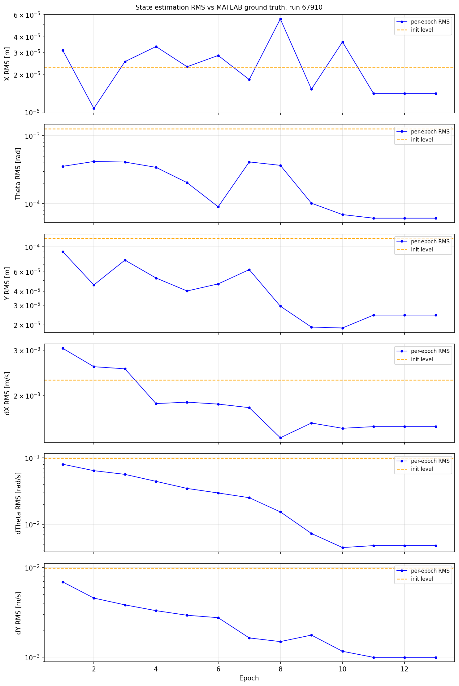

Slide 15
States worsen
Train for output prediction
  Cost does not target the states
For the augmentation phase could use a regularization for the physical states to keep close to the init
  If keeping physical states for the encoder adds value

Slide 16
Outline next week
Encoder for augmentation
Evaluate Quinten’s data for parameter recovery method
  See whether our baseline fits the data

Slide 17
Planning
Project overview
If possible can you share your vacation days with me

Slide 18
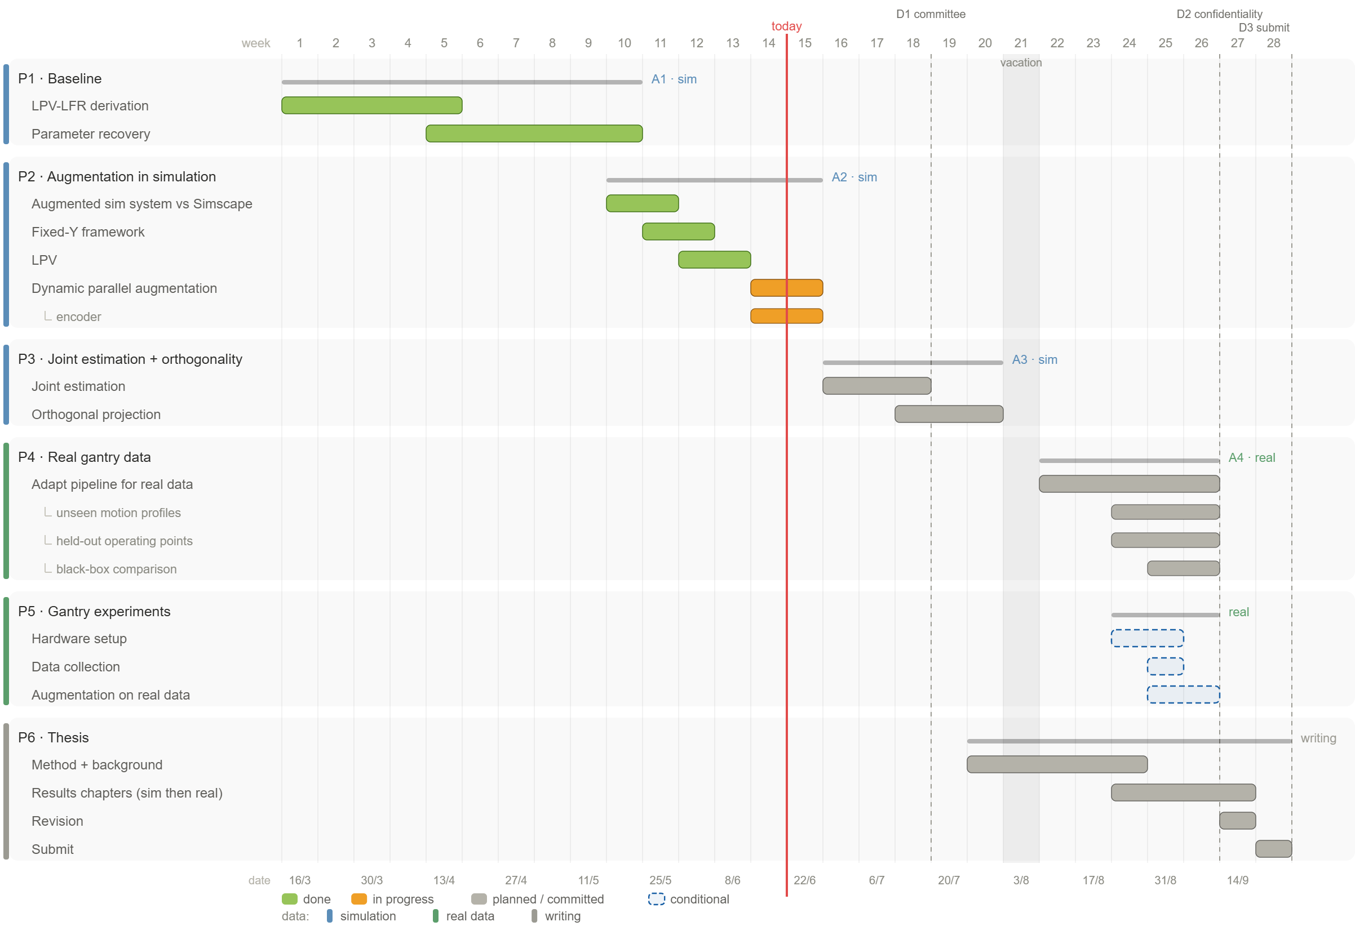

Slide 19


Slide 20


Slide 22
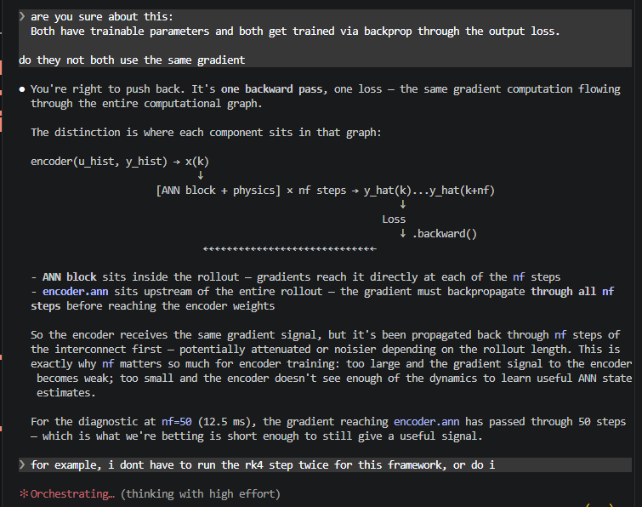
Additional

Slide 23
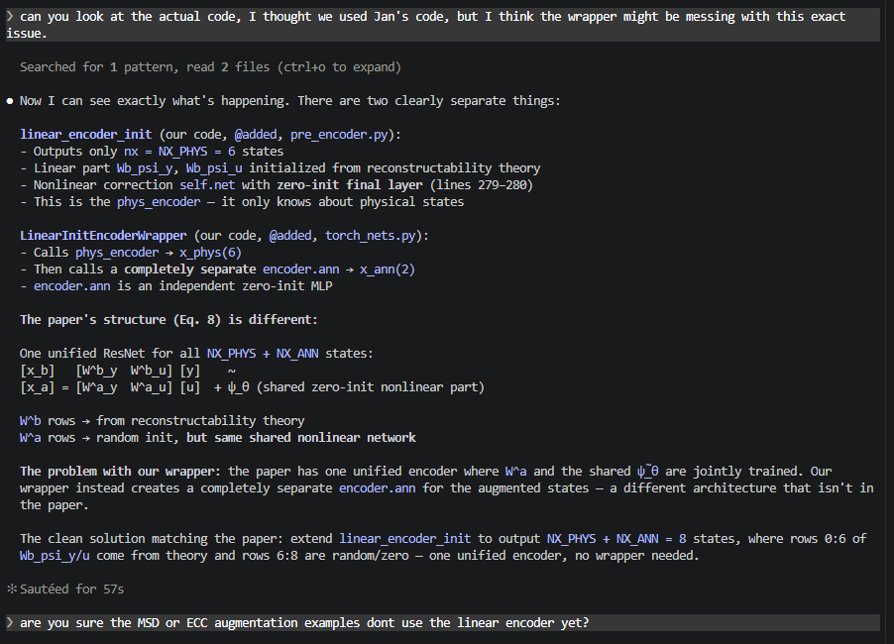
The problem with our wrapper: the paper has one unified encoder where W^a and the shared ψ̃_θ are jointly trained. Our
wrapper instead creates a completely separate encoder.ann for the augmented states — a different architecture that isn't in
the paper.

Slide 24
Complete model picture with formulas where does the encoder fit in (we change / add the formulas)

Slide 25
Vragen aan jan
Good call -- LinearInitEncoderWrapper is architecturally wrong (two separate nets) and the Eq. 8
extension is the right thing to do.
The plan would be:
New class @added linear_encoder_init_aug in pre_encoder.py:
- Copy Jan's linear_encoder_init verbatim
- Add nx_aug=0 parameter
- Add Wa_psi_y and Wa_psi_u as nn.Parameter with small random init for the nx_aug extra rows
- Expand self.net output from nx to nx + nx_aug (same zero-init final layer)
- Forward: x_lin = cat([Wb @ [y,u], Wa @ [y,u]]) + one shared self.net(...)
- When nx_aug=0 it behaves identically to Jan's original (backward compatible)
Then in torch_nets.py:
- Delete LinearInitEncoderWrapper (marked @added, so it's ours to remove)
Then in gantry_interconnect_dynamic.py:
- Replace LinearInitEncoderWrapper(...) with linear_encoder_init_aug(nx_aug=NX_ANN, ...)
One open question before implementing: what scale for the W^a random init? The paper says "randomly
initialized" but doesn't specify. Options:
1. PyTorch default (kaiming_uniform_, what nn.Linear uses)
2. Small scale like 0.01 so augmented states start near zero at initialization
3. Same scale as W^b (match physical state magnitude)
Option 2 is the safest -- augmented states starting near zero at init is fine and avoids large initial
state estimates that could destabilize early training.
Shall I proceed with this implementation?
One open question before implementing: what scale for the W^a random init? The paper says "randomly
initialized" but doesn't specify. Options:
1. PyTorch default (kaiming_uniform_, what nn.Linear uses)
2. Small scale like 0.01 so augmented states start near zero at initialization
3. Same scale as W^b (match physical state magnitude)

Slide 26
Encoder augmented states initialization
Random in physical states range?
Just kaiming_uniform_ pytorch method?
  Ask Jan
What actually matters:
  At initialization, x_a should not dominate or destabilize the early training signal where x_b is already well-placed. The augmented states
  should start small and grow as the training loss drives them. This argues for small or zero init for W^a specifically.
Kaiming initialization was specifically mathematically derived to account for the zero-cutoff in ReLU activations.

Slide 27
Normalization
Why the pipeline currently uses mean subtraction
The fit_sys.norm mean subtraction (y0, u_mean) was introduced for the Gantry_State_Block, not for the encoder. The physics block needs (y - y0)/std_y because y0 = Cd @ x_mean
is the operating point of the linearization. Removing the mean from the norm would require verifying how the output block and loss reconstruction handle the operating point.
The Gantry_State_Block was derived as a linearized model for deviations from an operating point. The state-space equations x(k+1) = A(theta) x(k) + B u(k) describe how the
system moves away from the operating point. If you feed it absolute stage positions instead of deviations, it is being asked to model the wrong quantity.
x_mean is used for LPV scheduling via the Y channel.

Slide 28
Encoder difference minimal
Channel NRMS A NRMS B_wrap NRMS B_native
q1 0.000150 0.000002 0.000002
q2 0.000095 0.000002 0.000002
q3 0.000044 0.000002 0.000002
dq1 0.000051 0.000001 0.000001
dq2 0.000341 0.000004 0.000004
dq3 0.000239 0.000001 0.000001

Slide 29
New data
Had to much force thought it was a bug compared to the positions but..
da_rms_with / da_rms_without:

Slide 30
Parameter recovery better?
The gap: our script uses Adam (local gradient-based). For structural validation, a global search gives stronger evidence. The recommended hierarchy:
1. Differential Evolution (DE) — derivative-free, population-based, well-tested for 10-30 mechanical parameters. ~1k-5k ODE simulations, feasible in minutes for a 6-state
system.
2. Multi-start Adam as refinement after DE.

Slide 31
The real solution: decouple the two purposes
The experiments have two distinct jobs:
┌───────────────────────┬─────────────────┬────────────────────────────┐
│ Purpose │ Trajectories │ What excites it │
├───────────────────────┼─────────────────┼────────────────────────────┤
│ Y-scheduling coverage │ T1, T5 │ Y motion, broadband forces │
├───────────────────────┼─────────────────┼────────────────────────────┤
│ MSD identification │ T3, T4, T7, T10 │ X motion → 150 Hz coupling │
└───────────────────────┴─────────────────┴────────────────────────────┘
Narrowband multisine only belongs in trajectories with significant X motion. Y-only experiments (T1, T5) simply cannot excite the MSD without violating the small-signal
assumption — and they don't need to. The MSD parameters (fa, ζ, ma) don't vary with Y-scheduling position; they're fixed physical properties.

Slide 33
New data
Multisine now from 130-180hz for MSD data
  No joint estimation

Slide 34
FRF zetten van het systeem
Kijken wat te doen met verschillende nfs voor baseline en parameters
  Moet iets fatsoenlijks kunnen laten zien..

Slide 35
Settle time
---
Envelope time constant:
$$\tau = \frac{1}{\zeta \omega_n} = \frac{1}{\zeta \cdot 2\pi f_n}$$
\tau = \frac{1}{\zeta \omega_n} = \frac{1}{\zeta \cdot 2\pi f_n}
Settling time to tolerance $\varepsilon$:
$$t_s = \frac{-\ln \varepsilon}{\zeta \omega_n} \approx \frac{4}{\zeta \omega_n} \quad (2%),\quad \frac{3}{\zeta \omega_n} \quad (5%)$$
t_s = \frac{-\ln \varepsilon}{\zeta \omega_n}
Q factor (from FRF):
$$Q = \frac{f_r}{\Delta f_{3\text{dB}}} = \frac{1}{2\zeta}$$
Q = \frac{f_r}{\Delta f_{3\,\text{dB}}} = \frac{1}{2\zeta}
Time constant from Q (nonparametric):
$$\tau = \frac{Q}{\pi f_r}$$
\tau = \frac{Q}{\pi f_r}
---
Your numbers (f_r = 157 Hz, zeta = 0.05, Q = 10):
$$\tau = \frac{1}{0.05 \cdot 2\pi \cdot 157} \approx 20,\text{ms}, \qquad 5\tau \approx 100,\text{ms}$$

Slide 36
Normalization laten zien 4000

Slide 37
Normalization issue
i mean i think if for the initalization it uses from the gantry system and that uses normalize_linear_ss_matrices, that sounds ( ° ° )
correct to me? given jan's approach. ( .. )
but we need to update with the data the encoder, but then we start with a mismatch. so i dont know the right solution.

Slide 38
● This is the actual design tension worth naming clearly.
---
Jan's original approach is internally consistent
In Jan's setup (baseline, no augmentation), normalize_linear_ss_matrices uses statistics from a simulation of the FP model itself, and the
pipeline normalization also uses statistics derived from that same baseline data. The two std_x values match by construction -- the encoder lives
in one consistent normalized space.
---
What broke in our augmented setup
We changed the training data to come from the augmented simulation (with MSD). Now:
- The D-055 fix uses std_x from the augmented data (lines 148-149, FD on augmented y) -- because that's what the pipeline sees at every step
- But normalize_linear_ss_matrices still uses baseline_states.npz -- the FP model simulation without MSD
So W^b is built in the baseline model's normalized space, but every forward pass applies a convention fix using the augmented data's normalized
space. Those two spaces are slightly different (mainly velocity channels).
---
The actual problem: the D-055 fix and W^b must use the same std_x
The D-055 fix's job is to convert from the pipeline convention (x - x_mean)/std_x to the pure-scaled convention x/std_x that W^b expects, then
back. For that conversion to be correct, the std_x in the D-055 fix must be exactly the same std_x that was used when building W^b inside
normalize_linear_ss_matrices.
If they differ, the D-055 fix applies the wrong offset and W^b's output is consistently miscaled. That error is constant -- the network can
absorb it over training -- but it means the analytical initialization advantage is partially wasted.
---
The two consistent options
Option A -- Jan's approach, stay with FP model statistics everywhere:
Use baseline/FP model std_x for BOTH normalize_linear_ss_matrices AND the D-055 fix buffers. W^b and the convention fix are in the same space.
The cost: the pipeline normalization (global std_x) differs slightly from the D-055 buffers, meaning the training data and the encoder convention
are in slightly different spaces.
Option B -- data statistics everywhere:
Use augmented data std_x (FD from training y, already computed at line 146) for BOTH normalize_linear_ss_matrices AND the D-055 fix. W^b is
initialized in the data's normalized space, and the D-055 fix uses the same space. Internally consistent, and matches the training data.
The current code is neither -- it mixes the two, which is the mismatch.
---
Which is better?
Option B is probably cleaner for the augmented case: the encoder is trained on augmented data, so the normalization should reflect that data.
Option A would require separately tracking two different normalization sources (FP model vs data), which complicates the code.
But in practice the difference is small. This matters most at initialization (where analytical W^b quality is highest) -- after a few training
epochs the weights have drifted and the starting point matters less.

Slide 39
(model = true system, ANN frozen at zero), model propagation error is near zero, so it's essentially pure encoder quality. In the augmented case
later, these two error sources will mix.

Slide 40
Does the MSD in the data hurt this?
No -- and here's why: the MSD doesn't show up in std_x at all for position channels. Positions are kinematically P_inv @ y regardless of MSD
dynamics. So std_x[0:3] is identical whether you use baseline or augmented data.
For velocity channels, the MSD adds a small coupling force to the Y dynamics. This changes the velocity trajectories slightly, so std_x[3:6] from
augmented data will differ fractionally from baseline. But that's not a problem -- it's actually CORRECT. The encoder is being trained to
reconstruct the augmented system's physical states, so std_x should reflect those states' actual spread, not the baseline model's.
Using augmented data statistics for normalization is therefore more consistent: you're normalizing W^b into the same space where the training
targets live.
---
The actual issue with the current code
Lines 140-146 already compute x_all from the training data via P_inv + FD. This gives you approximate x_logical from the augmented sim --
positions exact, velocities with FD noise but reflecting augmented dynamics. The global std_x at line 149 is correctly built from this.
But then inside build_model, if baseline_states.npz exists, it overwrites x_phys_all with states from the BASELINE simulation (no MSD) before
calling normalize_linear_ss_matrices. So W^b ends up built with one std_x (baseline), while the D-055 fix and the training loop both use a
different std_x (from augmented data FD).
The path at lines 140-146 already does the right thing. The baseline_states.npz fallback path was set up before the augmented training data
existed and it's now the source of the inconsistency.
---
Fundamental limitation that no normalization choice can fix
The FP model matrices (A, B, C, D) passed into normalize_linear_ss_matrices are from the BASELINE linearization -- the 6-state gantry without
MSD. W^b built from these is the best LTI reconstructor under baseline dynamics. The augmented system has slightly different dynamics (MSD
coupling), so W^b will always have some residual error for the physical states.
The normalization choice doesn't change this. It just determines whether the error is expressed in consistent units or not. Using training data
statistics throughout makes the space consistent -- W^b error is small and the ANN correction term will absorb it during training.
---
Bottom line
The right std_x for normalize_linear_ss_matrices is from the training data, which is what x_all at line 146 already gives you. The
baseline_states.npz path is the inconsistency -- it was useful before augmented training data existed, but now it introduces a mismatch. The
cleanest fix is to not use it for W^b normalization and instead use x_all consistently throughout.
✻ Churned for 54s
❯ but this normalization is used always for the encoder not only initialziation? each update step?
● No -- and this changes the severity of the mismatch significantly.
normalize_linear_ss_matrices is called once, inside build_model, only to compute the initial values of Wb_psi_y and Wb_psi_u. Those are
nn.Parameter tensors -- after initialization they're just free parameters, updated by the optimizer every step like any other weight. The
function is never called again during training.
What IS used at every forward pass is the D-055 fix: the buffers std_x, x_mean, u_mean, std_u, y0, ystd that are stored on the encoder. These
come from the global normalization (lines 148-149 of the training script -- FD on augmented sim y). That part is consistent with the training
data and stays fixed throughout training.
So the picture is:
┌─────────────────────────────────────────┬────────────────────┬───────────────────────────────────┬──────────────────────────────────────┐
│ What │ When │ Source │ Critical? │
├─────────────────────────────────────────┼────────────────────┼───────────────────────────────────┼──────────────────────────────────────┤
│ normalize_linear_ss_matrices std_x │ Once, at init │ baseline_states.npz │ Low -- only sets W^b starting point │
├─────────────────────────────────────────┼────────────────────┼───────────────────────────────────┼──────────────────────────────────────┤
│ D-055 fix buffers (std_x, x_mean, etc.) │ Every forward pass │ FD on augmented y (lines 148-149) │ Yes -- this is baked into every step │
└─────────────────────────────────────────┴────────────────────┴───────────────────────────────────┴──────────────────────────────────────┘
The mismatch I flagged is a one-time initialization issue. W^b starts from a slightly wrong scale for velocity channels, but gradient descent
will correct it. The D-055 fix (which runs every step) is already using the right source -- the training data statistics.
So the normalization mismatch is real but not a training-correctness problem. It means W^b needs a few more gradient steps to reach its
equilibrium from a slightly off starting point. That's not worth fixing ahead of a first training run.
✻ Churned for 33s
❯ i mean i think if for the initalization it uses from the gantry system and that uses normalize_linear_ss_matrices, that sounds correct to me?
given jan's approach.
but we need to update with the data the encoder, but then we start with a mismatch. so i dont know the right solution.
● This is the actual design tension worth naming clearly.
---
Jan's original approach is internally consistent
In Jan's setup (baseline, no augmentation), normalize_linear_ss_matrices uses statistics from a simulation of the FP model itself, and the
pipeline normalization also uses statistics derived from that same baseline data. The two std_x values match by construction -- the encoder lives
in one consistent normalized space.
---
What broke in our augmented setup
We changed the training data to come from the augmented simulation (with MSD). Now:
- The D-055 fix uses std_x from the augmented data (lines 148-149, FD on augmented y) -- because that's what the pipeline sees at every step
- But normalize_linear_ss_matrices still uses baseline_states.npz -- the FP model simulation without MSD
So W^b is built in the baseline model's normalized space, but every forward pass applies a convention fix using the augmented data's normalized
space. Those two spaces are slightly different (mainly velocity channels).
---
The actual problem: the D-055 fix and W^b must use the same std_x
The D-055 fix's job is to convert from the pipeline convention (x - x_mean)/std_x to the pure-scaled convention x/std_x that W^b expects, then
back. For that conversion to be correct, the std_x in the D-055 fix must be exactly the same std_x that was used when building W^b inside
normalize_linear_ss_matrices.
If they differ, the D-055 fix applies the wrong offset and W^b's output is consistently miscaled. That error is constant -- the network can
absorb it over training -- but it means the analytical initialization advantage is partially wasted.
---
The two consistent options
Option A -- Jan's approach, stay with FP model statistics everywhere:
Use baseline/FP model std_x for BOTH normalize_linear_ss_matrices AND the D-055 fix buffers. W^b and the convention fix are in the same space.
The cost: the pipeline normalization (global std_x) differs slightly from the D-055 buffers, meaning the training data and the encoder convention
are in slightly different spaces.
Option B -- data statistics everywhere:
Use augmented data std_x (FD from training y, already computed at line 146) for BOTH normalize_linear_ss_matrices AND the D-055 fix. W^b is
initialized in the data's normalized space, and the D-055 fix uses the same space. Internally consistent, and matches the training data.
The current code is neither -- it mixes the two, which is the mismatch.
---
Which is better?
Option B is probably cleaner for the augmented case: the encoder is trained on augmented data, so the normalization should reflect that data.
Option A would require separately tracking two different normalization sources (FP model vs data), which complicates the code.
But in practice the difference is small. This matters most at initialization (where analytical W^b quality is highest) -- after a few training
epochs the weights have drifted and the starting point matters less.
✻ Churned for 59s
❯ I think we should go with option B. can you read jan's paper again for the initialziation and determine whether this is a valid solution?
Searched for 1 pattern, read 2 files, recalled 1 memory (ctrl+o to expand)
● The key passage is Section 3.5 of the paper ("Baseline model normalization", page 4):
▎ "For T_x, the standard deviation σ_x is determined in the baseline states of the model x̄. These states can be obtained by, e.g., simulation of
the baseline model with nominal input and initial conditions."
Note also: σ_u is "derived from D_N" (the training data), but σ_x specifically comes from the baseline model simulation, not from the data.
---
Option B is not what Jan prescribes.
Jan's prescription is explicit: σ_x for T_x (and therefore for normalize_linear_ss_matrices) comes from simulating the baseline FP model. That is
what baseline_states.npz contains. So the current code using baseline_states.npz inside build_model is actually implementing Jan's approach
correctly.
---
The actual inconsistency is in the D-055 fix, not in normalize_linear_ss_matrices
The D-055 fix passes the global std_x (lines 148-149, FD on training data y) as the x_off buffer. But W^b was built with std_x from
baseline_states.npz. The two are different. So the output conversion in the D-055 fix applies the wrong scale:
- W^b output is in x / std_x_baseline (from normalize_linear_ss_matrices)
- D-055 subtracts x_mean / std_x_data (from global normalization)
- These two std_x don't match, so the conversion is slightly wrong
To be consistent with Jan's paper, the D-055 fix's std_x and x_mean buffers should come from the baseline model simulation (same source as
normalize_linear_ss_matrices), not from the FD-on-data statistics.
---
Magnitude: still small
The position channels have identical std_x in both sources (kinematically exact). Only velocity channels differ, and only slightly due to weak
MSD coupling (~84 µm). So the error is small in practice -- but it is a genuine inconsistency relative to Jan's design.
The fix is not to switch to Option B, but to pass baseline_states.npz std_x also to the D-055 fix buffers, so both sides of the conversion use
the same source. Should we look at that?
✻ Sautéed for 1m 45s
❯ I think we should look at that, what is your opinion on that.
● My opinion: don't fix it now, and here's the reasoning.
The case for fixing it:
It's a genuine inconsistency with Jan's paper. The D-055 fix is supposed to be an exact bridge between the pipeline convention and the W^b
convention. If the two std_x values differ, the conversion is slightly wrong and the analytical initialization advantage is partially wasted at
step 0.
Why I'd hold off:
First, the magnitude. The only affected channels are velocities (dq1, dq2, dq3). Position std_x is identical in both sources (kinematically exact
from y). The velocity difference is driven by 84 µm MSD coupling on meter-scale dynamics -- likely under 1% difference in std_x. The
initialization error this introduces is proportionally tiny.
Second, W^b is trainable. The Wb_psi_y and Wb_psi_u tensors are nn.Parameter -- they get updated every step. Even if the initial convention is
slightly off, the optimizer corrects it within the first few epochs. The D-055 buffers (std_x, x_mean) are fixed, but the weights adapt around
them. So the inconsistency costs a few gradient steps, not training quality.
Third, the fix adds a dependency. Right now baseline_states.npz is only used inside build_model. To thread its std_x into the D-055 fix, you'd
need to either compute it separately or restructure the constructor. That's added complexity for a very small payoff.
Fourth, diag8 already passes all four initialization checks with the current code. The encoder's physical NRMS is small (max 0.21 for dq2). The
inconsistency is not observable at initialization.
What I'd do instead: run a first training run with the current code and check whether loss converges cleanly. If the training is well-behaved,
this inconsistency is not a blocking problem and can be logged as a known minor deviation from Jan's exact prescription. If there's some
unexpected initialization problem at that point, then investigate this.
Log it in decisions.md as a known issue and move on.

Slide 41
Kijken Andere metrics jan
Baseline 5hz dynamica zou veel te veel samples zijn
  Meerdere epochs?
    Allemaal maar 10

Slide 43
● Now I see the full picture. The two methods are:
Method 1: normalize_linear_ss_matrices (in utils.py)
- Uses determine_std_T → Tix = diag(std(x)), std-only, no mean subtraction
- Produces "pure-scaled" normalized matrices: A_bar = diag(1/std_x) @ A @ diag(std_x)
- Used to build the encoder's linear map (W^b, W^a)
Method 2: System_data_norm (deepSI pipeline)
- Mean + std: x_norm = (x_phys - x_mean) / std_x
- Used throughout training: what the model receives as input and produces as output
These two conventions are different. The encoder's linear map is built in the pure-scaled space, but during training the model runs in the mean+std space.
For Y-axis (x[2] ≈ 0.3 m), this offset is significant.
The fix is in linear_encoder_init_aug — the D-055 convention fix (lines 454-465):
- Before W^b: adds u_off = u_mean/std_u and y_off = y0/ystd to convert pipeline → pure-scaled
- After W^b: subtracts x_off = x_mean/std_x to convert pure-scaled → pipeline
This is enabled in your training script because all 6 parameters (u_mean, std_u, y0, ystd, x_mean, std_x) are passed to linear_encoder_init_aug.
However, there's still a residual inconsistency: Gantry_State_Block receives std_x = x_all.std() + 1e-8, but normalize_linear_ss_matrices computes std_x
via determine_std_T which uses np.std(x_all) (no epsilon). The difference is 1e-8 — negligible for real signals.
The deeper issue for your training problem: the ANN operates on the full normalized state vector [x_phys_norm, x_aug_norm, u_norm]. The augmented states
x[6:8] live in a completely unnormalized space — they start at zero with no defined std. The ANN learns on x[6:8] without any scaling reference, while the
physical states have well-defined normalization from the FP model. This scale imbalance could affect the gradient magnitude balance between rows [0:6] and
rows [6:8] in the ANN output — which is exactly what T5 and T7 will quantify.
Do you want to run the updated diagnostic (T1–T7) now with the small N_BATCHES=2 setting to verify T5–T7 work, then restore full parameters?

Slide 45
Fix augmented
Here is the problem statement:
---
Problem: ANN augmentation of a state-space model with marginally stable physical dynamics
System
A 6-state discrete-time mechanical system (a precision XY gantry with Y-axis bearing), identified at 4 kHz. Physical state: x_phys =
[q1, q2, q3, dq1, dq2, dq3] (3 positions, 3 velocities in logical coordinates). Input: u (3 motor forces). Output: y = Cd @ x_phys (3
stage positions).
The linearized discrete-time A matrix (Ad = expm(Ac / 4000)) has 2 poles exactly at |z| = 1.0 (rigid-body modes, no spring stiffness)
and 4 poles at |z| > 0.9992. All 6 poles have amplification factor ~400x over an nf=400 step rollout.
Goal
Augment the physical model with a neural network (ANN) to capture unmodeled dynamics: specifically a hidden dynamic absorber
(mass-spring-damper, ~2 states) attached to the Y-axis. The target architecture is an additive state-space augmentation:
x_aug[k+1] = x_aug[k] + ann(x[k], u[k]) # ANN updates augmented states only
x_phys[k+1] = f_phys(x_phys[k], u[k]) # physical block (fixed, no trainable params)
y[k] = Cd @ x_phys[k] # output reads only physical states
where x = [x_phys; x_aug] is the full state and ann is a zero-initialized feedforward network.
The problem
Two constraints are in conflict:
1. ANN cannot update physical state rows. Routing any ANN output to x_phys blows up catastrophically in a single gradient step (~800x
validation degradation). Cause confirmed empirically and analytically: the integrators at z=1 amplify any additive ANN perturbation by
~nf = 400x per step during BPTT (backpropagation through time). Gradient clipping at max_norm=1.0 had no effect (the global grad norm
was already 0.26, below the clip threshold, and the blowup still occurred at 1634x).
2. ANN→x_aug produces zero gradient. If the ANN only updates x_aug, the gradient is always zero because y = Cd @ x_phys does not read
x_aug. The augmented states are structurally disconnected from the loss.
The reference framework (Jan Decuyper's model_augmentation library) routes ANN to all states, which works for his MSD benchmark because
min(1-|z|) = 4.4e-3 (all poles strictly inside unit circle, amplification = 4.4x at nf=400). That approach is incompatible with our
system by construction.
What has been tried and ruled out
- ANN → velocity rows [3,4,5] only: 836x blowup
- ANN → position rows [0,1,2] only: 798x blowup
- ANN → all states + clip_grad_norm_(1.0): 1634x blowup (clip inactive, grad was already 0.26)
- Reducing nf: blowup confirmed at nf=2 (1 step) as well
- All three blowup variants have similar gradient magnitudes (~0.17 for positions, ~0.017 for velocities); the blowup is not
gradient-scale driven
Research question
What augmentation architectures exist for physics-informed neural network state-space models where the physical subsystem has marginally
stable or unstable eigenvalues (poles at or near the unit circle), such that: (a) the ANN does not destabilize the physical dynamics,
and (b) the learned augmented states still have a gradient path to the loss? Specifically looking for:
- Output augmentation: y = Cd @ x_phys + C_aug @ x_aug with C_aug learned or initialized from physics
- Forcing term injection: x_phys[k+1] = f_phys(x_phys[k], u[k]) + B_aug @ x_aug[k] where B_aug is fixed and physics-derived (absorber
force on Y-axis)
- Delta-domain or continuous-time training reformulations that avoid the near-unit-circle sensitivity
- Provably stable augmentation architectures (Lyapunov-based, contraction-based)
- Any literature on BPTT instability in augmented state-space models and mitigation strategies
Keywords for search
- neural augmented state-space model marginally stable
- physics-informed neural network integrator pole training instability
- additive model augmentation stable training
- output equation augmentation state-space
- BPTT gradient explosion state-space marginal stability
- delta operator neural network system identification
- stable physical residual learning
The proof is clean. Key numbers:
┌────────────────┬───────────────┬───────────────┐
│ System │ min(1-|z|) │ amp at nf=400 │
├────────────────┼───────────────┼───────────────┤
│ Gantry 4kHz │ 0.000 (exact) │ 400x │
├────────────────┼───────────────┼───────────────┤
│ Jan's MSD 50Hz │ 4.4e-3 │ 4.4x │
└────────────────┴───────────────┴───────────────┘
Gantry has 2 poles exactly at z=1 (rigid-body X and Y modes, K[q1]=K[q3]=0) and 4 more poles within 7.5e-4 of the unit circle (all
amplify ~380-400x at nf=400). Jan's worst eigenvalue amplifies 4.4x at nf=400 — 90x less than the gantry integrators. With Jan's nf=200,
it's only 2.2x.
This quantitatively explains the diag13 results: 836x empirical blowup ≈ 400x eigenvalue amplification × nonlinear LPV coupling between
modes. The clipping result (grad_norm=0.26 < max_norm=1.0, still 1634x blowup) is also consistent — even with zero clipping, 400x per
integrator makes any lr=1e-4 step catastrophic.
The architectural conclusion is now on solid ground: Jan's method 1:1 requires all DT poles strictly inside the unit circle. The gantry
violates this by construction (rigid-body modes). Options B or C are not alternatives to Jan's method — they're the necessary adaptation
to preserve the interconnect architecture while avoiding the integrator paths.
Do you want me to log this to docs/decisions.md and update tasks/handoff.md now, then move to planning Option B or C?
the gantry at 4kHz has near-unit-circle eigenvalues

Slide 46
Research backings
● The research is back. Key findings:
Your diagnosis is formally confirmed. Pascanu et al. (2013) Theorem 1 guarantees BPTT explosion when sigma_1(A_phys) >= 1 with long
rollouts. Your two unit-circle poles give linear (not exponential) amplification = ~2 * nf = 800x, which matches the empirical 836x.
Gradient clipping addresses large-gradient events, not structural amplification — consistent with why clip_norm=1.0 had no effect.
Constraint 2 also has a formal name. Verhaegen & Verdult (2007): if C_aug = 0, the pair (A_aug, C_aug) is unobservable by definition.
The zero gradient is a structural algebraic obstruction, not numerical. No routing trick fixes it.

Slide 47
● Here's the full picture.
How y connections work (interconnect.py:282):
if output_signal_ix <= 1: connection_function_method = "additive"
Connecting any block to "y" is additive by default — multiple blocks sum into y automatically.
Parameterized_Linear_Output_Block with no D (blocks.py:194-200):
- D defaults to torch.empty(0,0) → nu=0 → no D term, block computes only C @ x
- C is nn.Parameter (trainable), but D doesn't exist
---
The correct two-block pattern for our case is simpler than Jan's LPF:
Jan uses D=[[1.0]] passthrough because his physical y flows through the LPF block. We don't need that — we can have
two blocks each contributing additively to y directly:
# Block 1: fixed physical output — Cd_norm stays in register_buffer (not nn.Parameter)
out_phys = Linear_Output_Block(C=Cd_norm, D=Dd_np)
ic.connect_signals("x", out_phys, "concat", selection_matrix(PHY_IX, nxd))
ic.connect_block_signals(out_phys, ["u"], ["y"]) # additive to y
# Block 2: trainable aug output — only C_aug is nn.Parameter, no D term
out_aug = Parameterized_Linear_Output_Block(C=C_aug_init, flag_loss_reg=False)
# (D omitted → empty → nu=0 → no D term at all)
ic.connect_signals("x", out_aug, "concat", selection_matrix(AUG_IX, nxd))
ic.connect_block_signals(out_aug, [], ["y"]) # additive to y, no u input
Result: y = Cd@x_phys + Dd@u + C_aug@x_aug with Cd fixed and only C_aug trainable.
---
To answer your two questions:
1. Did Jan already have this? Yes — the two-block additive pattern is Jan's output_aug=True case, though he uses a
more complex LPF structure because his aug output is a dynamic filter, not a static C_aug. The core mechanism (fixed
Linear_Output_Block + separate Parameterized_Linear_Output_Block, additive to y) is his.
2. What did we do wrong in gantry_interconnect_dynamic.py? We merged Cd and C_aug into one
Parameterized_Linear_Output_Block(C=C_full) — we invented our own pattern instead of following his, and accidentally
made Cd trainable.
---
Want me to write the test diagnostic (diag17) to verify the two-block fix gives Cd fixed + ANN gradient nonzero,
before touching gantry_interconnect_dynamic.py?

Slide 48
Correct. Both fixes trace back to patterns Jan already wrote:
- Routing fix (D-065): expansion_matrix(state_aug_state_indices_output, nx_model) — already in
msd_ndof_interconnect_fit.py:207
- Output fix: Linear_Output_Block (fixed) + separate Parameterized_Linear_Output_Block (C_aug only) — already in
msd_ndof_interconnect_fit.py:163,378
We didn't implement a new architecture. We deviated from Jan's patterns twice when building the gantry model, and
then diagnosed why each deviation broke training.
What we actually contributed:
1. Diagnosis — identified that the gantry's |z|=1 poles make the routing deviation catastrophic (safe for MSD, not
for gantry)
2. Verification — diag14–17 prove the claims in simulation before touching the real model
---
So the framing to Jan changes:
▎ We found two places where our gantry implementation deviated from your journal code. Both deviations caused
training failures:
▎ 1. Routing: we used connect_block_signals(ann, ["x","u"], ["xp"]) (all state rows) instead of your
expansion_matrix(aug_ix) pattern — caused blowup on |z|=1 poles (verified in diag16)
▎ 2. Output: we merged Cd and C_aug into one Parameterized_Linear_Output_Block instead of your Linear_Output_Block +
separate Parameterized pattern — caused Cd_norm to drift (verified in diag17, 272x val blowup)
▎ Both fixes are already in your codebase. We just need to apply them correctly to gantry. Is there anything
non-obvious about why the gantry case requires these patterns that we should be aware of?

Slide 50
What to beat
2. Oracle augmented simulation — best achievable with perfect MSD state
Run the simulation with the learned C_aug matrix but with GT x_aug (delta_a, vdelta_a from the mat file) injected at
each timestep instead of the model's own prediction. This answers: "if the encoder tracked the MSD state perfectly
at every step, what NRMS would we get?" That oracle NRMS sets the realistic ceiling of what 100 epochs of training
can approach.

Slide 51
This doc is very revealing. From augmentation-open-questions.md Q4 and Q5:
- MSD resonance at ~150 Hz → period = 6.7ms = 27 samples at 4kHz
- nf=400 (100ms) covers ~15 MSD periods — set for the gantry's hidden absorber, not the benchmark MSD
- The doc says na_nb should be ~120 samples (30ms) to cover ~4.5 MSD periods

